Slide 1
Human Exposure Model from Corn/Cattle Muscle
PFAS Concentration in Soil
Corn stover
Cattle Muscle
Uptake into corn plant
PFAS Exposure to Humans
Corn products

Slide 2
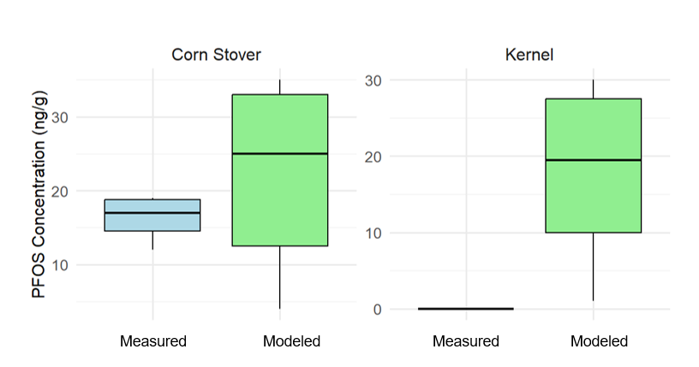
From Soil to Corn Plant
Bioaccumulation Factors (BAF)
PFAS Concentration in Soil
Sites | PFBA | PFPeA | PFHxA | PFHpA | PFOA | PFNA | PFDA | PFUnDA | PFDoDA | PFBS | PFHxS | PFOS | ∑PFAAs
C1 | 7.42 | 1.59 | 2.90 | 0.08 | 0.00 | 0.19 | 0.32 | 1.25 | 3.00 | 5.00 | 4.00 | 1.25 | 0.14
C2 | 1.03 | 0.23 | 2.49 | 0.04 | 0.00 | 0.13 | 0.39 | 1.00 | 3.00 | 5.00 | 4.00 | 0.15 | 0.06
C3 | 8.21 | 3.02 | 9.38 | 0.03 | 0.00 | 0.19 | 0.35 | 1.00 | 1.00 | 5.00 | 4.00 | 3.29 | 0.57
C4 | 2.79 | 0.36 | 0.89 | 0.04 | 0.00 | 0.06 | 0.27 | 2.50 | 3.00 | 4.00 | 0.40 | 0.00 | 0.03
C5 | 3.07 | 1.23 | 3.40 | 0.08 | 0.01 | 2.50 | 0.32 | 1.67 | 3.00 | 5.00 | 4.00 | 5.00 | 0.41
C6 | 6.77 | 3.78 | 5.56 | 0.19 | 0.02 | 0.63 | 0.35 | 5.00 | 3.00 | 5.00 | 4.00 | 5.00 | 0.76
C7 | 0.55 | 0.18 | 0.56 | 0.10 | 0.01 | 0.36 | 0.50 | 5.00 | 3.00 | 5.00 | 4.00 | 0.36 | 0.06
C8 | 4.95 | 2.28 | 4.13 | 1.08 | 0.01 | 0.50 | 0.44 | 1.67 | 3.00 | 5.00 | 4.00 | 0.13 | 0.46
C9(D) | 2.72 | 0.20 | 0.76 | 0.04 | 0.00 | 0.08 | 0.21 | 0.83 | 3.00 | 5.00 | 4.00 | 0.78 | 0.03
C10(D) | 11.28 | 1.09 | 1.42 | 0.78 | 0.00 | 0.14 | 1.00 | 5.00 | 3.00 | 16.00 | 4.00 | 0.06 | 0.19
BAF
Uptake into corn plant
Using the BAF for PFAS, we can calculate the concentration of PFAS in corn, based on data of PFAS concentration in soil
Parameter in use
BAF for different PFAS from soil to corn

Slide 3
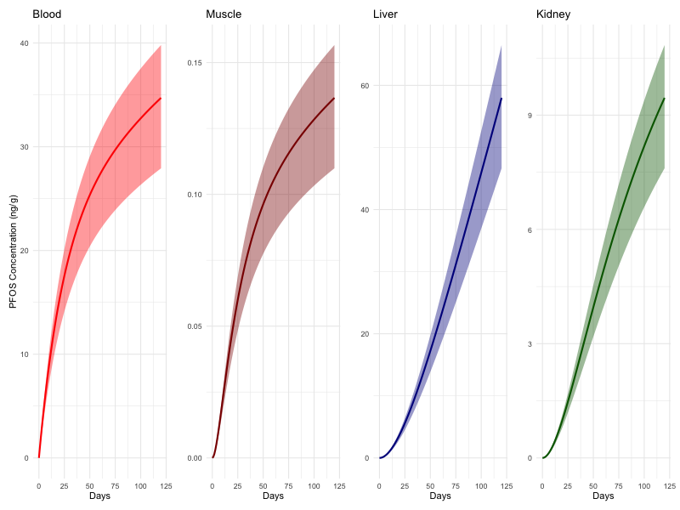
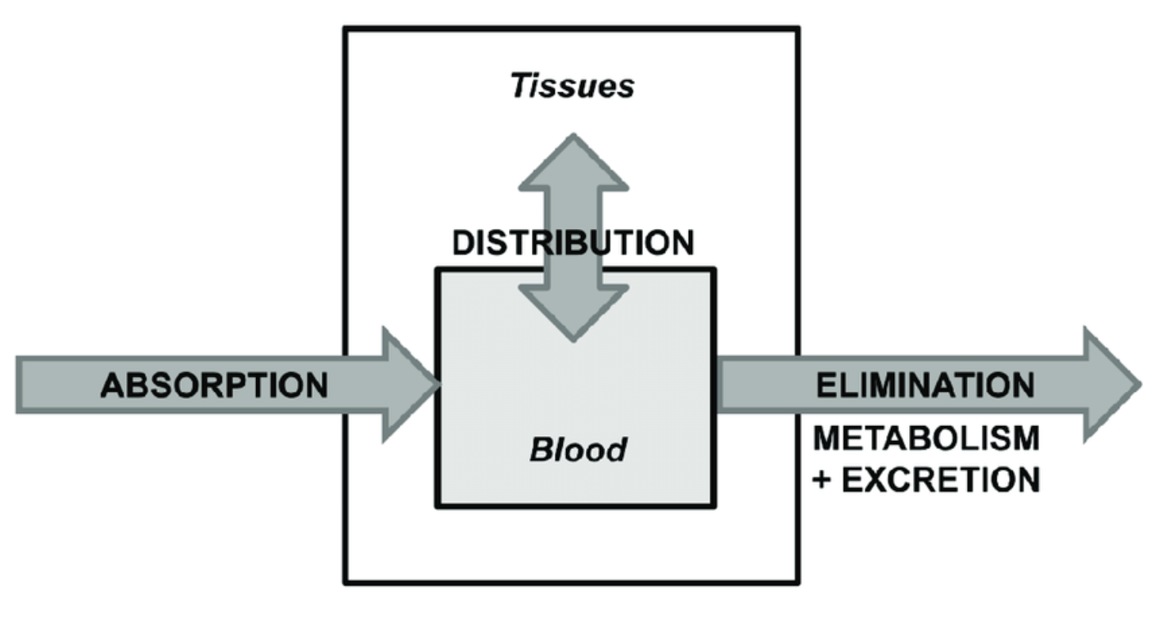
From Corn to Cattle Muscle
K_{e}, K₁₂
Corn stover
Cattle Muscle
Using two compartment toxicokinetic model, we can calculate the concentration of PFAS in cattle muscle, based on data of PFAS concentration in corn stover
Parameter in use:
Elimination Rate Constant K_{e}
Transfer factors between tissues K₁₂

Slide 4
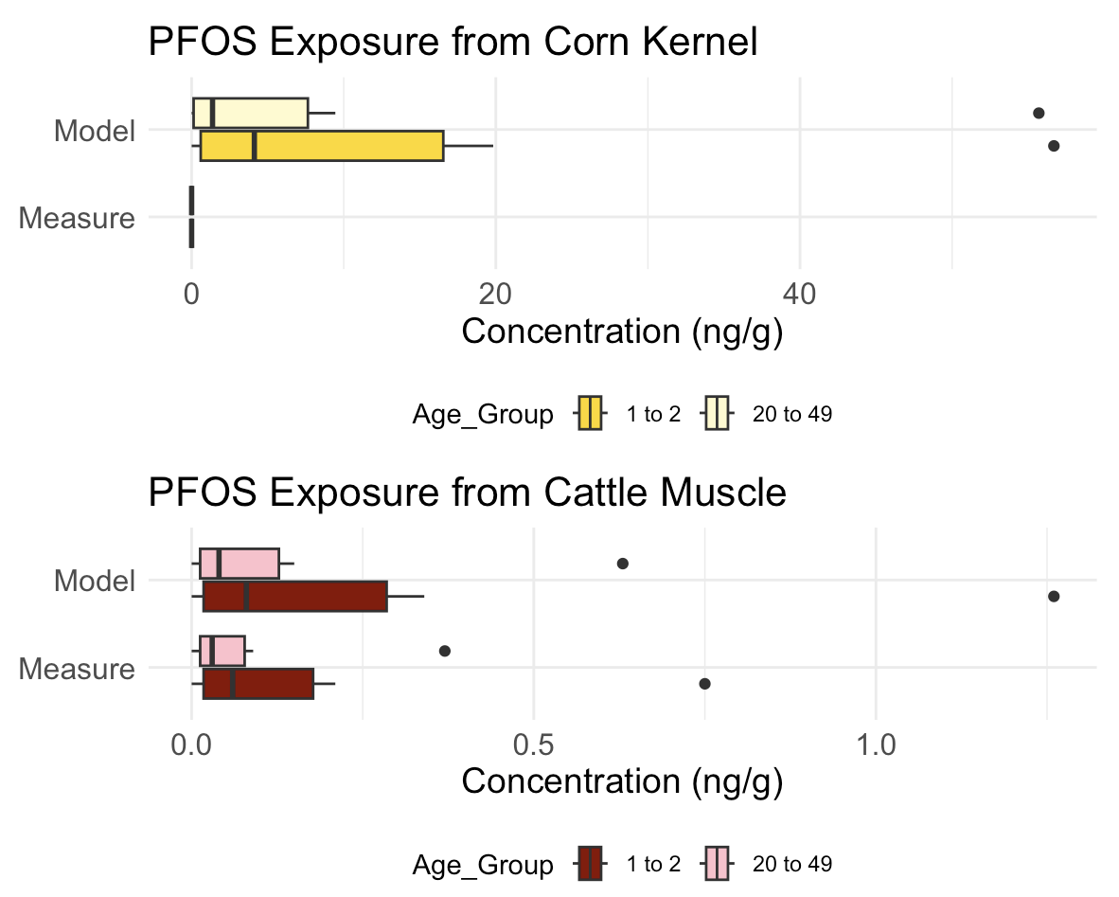
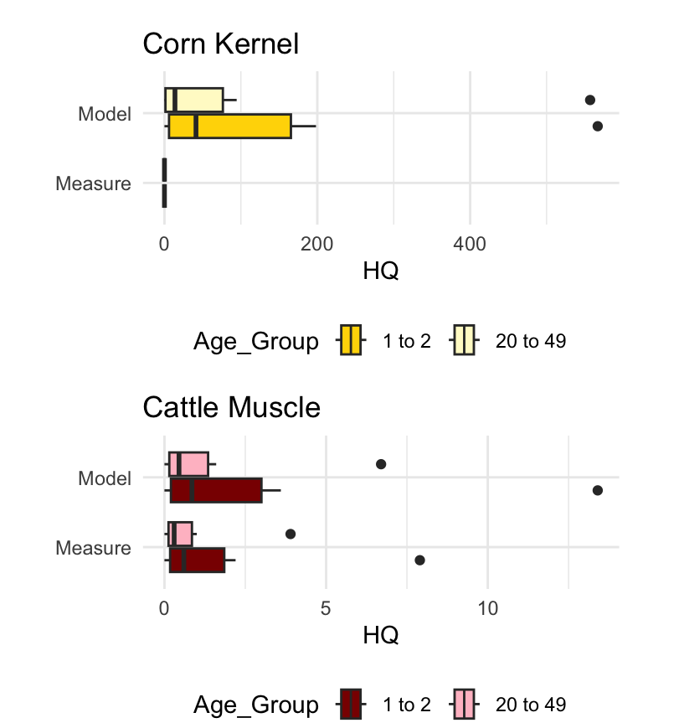
From Food to Human
Cattle Muscle
PFAS Exposure to Humans
Corn products
Consumption Rate for different food
 | All Field Corn |  | Beef Muscle
Age | P₅₀ | P₉₅ | P₅₀ | P₉₅
1 to 2 | 0.3 | 2.1 | 0.9 | 4.6
20 to 49 | 0.1 | 1 | 0.5 | 2.1
We can calculate the PFAS EDI, using concentration of PFAS in cattle muscle and corn kernel
Parameter in use:
Consumption Rate

Slide 5
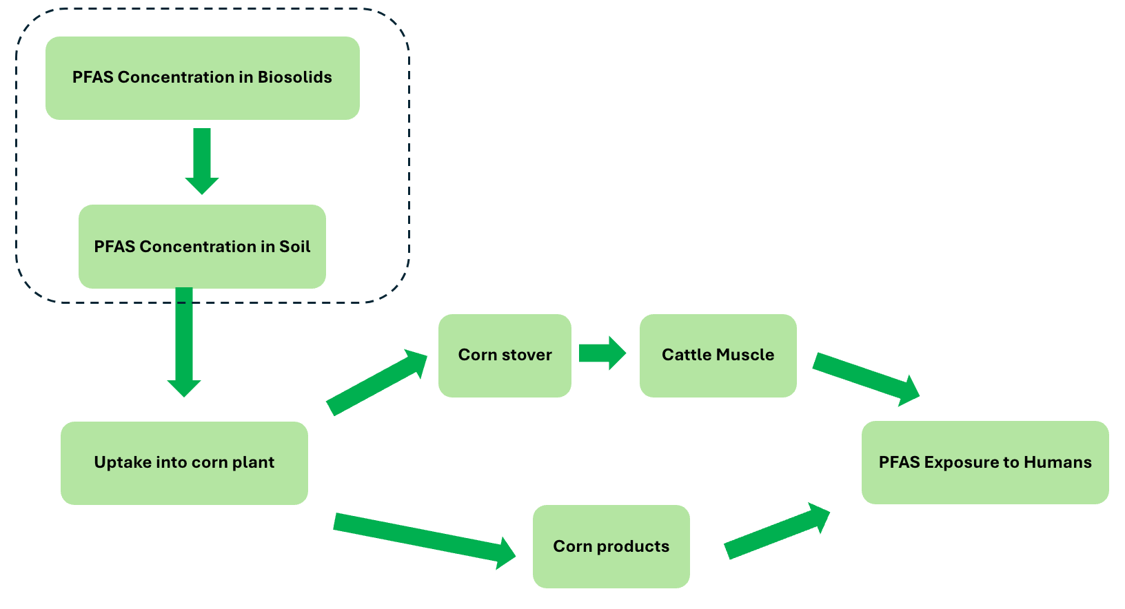
Model extension
PFAS Concentration in Biosolids
Parameters needed for different processes
BAF for different PFAS
Toxicokinetic model parameters for different PFAS
Consumption Rate for different Food products
What data we have
PFAS concentration in Soil
PFAS Concentration in Soil
Discussion
What we need
Transfer factor from biosolids to soil
suitable model from biosolids to soil
Assumption we need
Setting for the model above

